Slide 1
User Permission

Slide 2
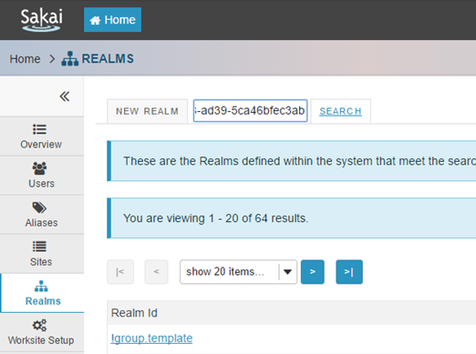
Creating new role using Realms Tool
Admin can create new role for a worksite by using Realms tool.
Creating a new role is as follows.
First, search the worksite that has to be added a new role.

Slide 3
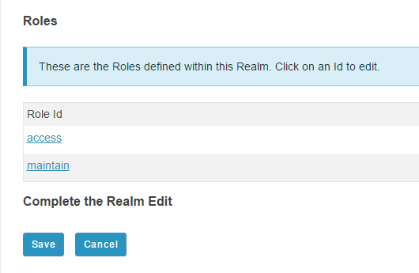
Creating new role using Realms Tool
Following the previous existing roles of the selected worksite.

Slide 4
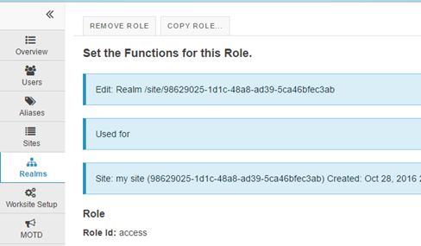
Creating new role using Realms Tool
Now, click on a role and copy that role.

Slide 5
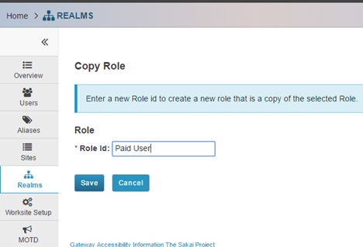
Creating new role using Realms Tool
Create new role id

Slide 6
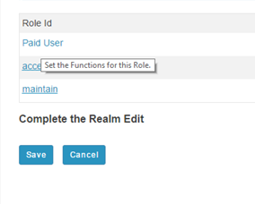
Creating new role using Realms Tool
Select the new role to set the functions for this role.

Slide 7
Available Permissions
alias.add
alias.del
alias.upd
annc.all.groups
annc.delete.any
annc.delete.own
annc.new
annc.read
annc.read.drafts
annc.revise.any
annc.revise.own
asn.all.groups
asn.delete
asn.grade
asn.new
asn.read
asn.receive.notifications
asn.revise
asn.share.drafts
asn.submit
assessment.createAssessment
assessment.deleteAssessment.any
assessment.deleteAssessment.own
assessment.editAssessment.any
assessment.editAssessment.own
assessment.gradeAssessment.any
assessment.gradeAssessment.own
assessment.publishAssessment.any
assessment.publishAssessment.own
assessment.questionpool.copy.own
assessment.questionpool.create
assessment.questionpool.delete.own
assessment.questionpool.edit.own
assessment.submitAssessmentForGrade
assessment.takeAssessment
assessment.template.create
assessment.template.delete.own

Slide 8
Available Permissions
assessment.template.edit.own
calendar.all.groups
calendar.delete.any
calendar.delete.own
calendar.import
calendar.new
calendar.options
calendar.read
calendar.revise.any
calendar.revise.own
calendar.subscribe
calendar.view.audience
chat.delete.any
chat.delete.channel
chat.delete.own
chat.new
chat.new.channel
chat.read
chat.revise.channel
content.all.groups
content.delete.any
content.delete.own
content.hidden
content.new
content.read
content.revise.any
content.revise.own
course_site_publish_service.publish
course_site_removal_service.removal
dropbox.maintain
dropbox.maintain.own.groups
dropbox.own
gradebook.editAssignments
gradebook.gradeAll
gradebook.gradeSection
gradebook.viewOwnGrades
lessonbuilder.read
lessonbuilder.seeall
lessonbuilder.upd

Slide 9
Available Permissions
mail.delete.any
mail.new
mail.read
mailtool.admin
mailtool.send
msg.emailout
msg.permissions.allowToField.allParticipants
msg.permissions.allowToField.groups
msg.permissions.allowToField.myGroupMembers
msg.permissions.allowToField.myGroups
msg.permissions.allowToField.roles
msg.permissions.allowToField.users
msg.permissions.viewHidden.groups
oauth.admin
pasystem.manage
poll.add
poll.deleteAny
poll.deleteOwn
poll.editAny
poll.editOwn
poll.vote
portal.chat.permitted
prefs.add
prefs.del
prefs.upd
realm.add
realm.del
realm.upd
realm.upd.own
realm.view.all
roster.export
roster.viewallmembers
roster.viewemail
roster.viewenrollmentstatus
roster.viewgroup
roster.viewhidden
roster.viewofficialphoto
roster.viewprofile
roster.viewsitevisits
rwiki.admin
rwiki.create
rwiki.read
rwiki.superadmin
rwiki.update

Slide 10
Available Permissions
scorm.configure
scorm.delete
scorm.grade
scorm.launch
scorm.upload
scorm.validate
scorm.view.results
section.role.instructor
section.role.student
section.role.ta
signup.attend
signup.attend.all
signup.create.group
signup.create.group.all
signup.create.site
signup.delete.group
signup.delete.group.all
signup.delete.site
signup.update.group
signup.update.group.all
signup.update.site
signup.view
signup.view.all
site.add
site.add.course
site.add.portfolio
site.add.project
site.add.usersite
site.del
site.del.softly.deleted
site.import.archive
site.roleswap
site.upd
site.upd.grp.mbrshp
site.upd.site.mbrshp
site.viewRoster
site.visit

Slide 11
Available Permissions
site.visit.softly.deleted
site.visit.unp
sitestats.admin.view
sitestats.view
syllabus.add.item
syllabus.bulk.add.item
syllabus.bulk.edit.item
syllabus.redirect
user.add
user.del
user.upd.any
user.upd.own
user.upd.own.email
user.upd.own.name
user.upd.own.passwd
user.upd.own.type
usermembership.view

Slide 12
Available Permissions
Now finished creating a new role by selecting permissions from the available ones.

Slide 13
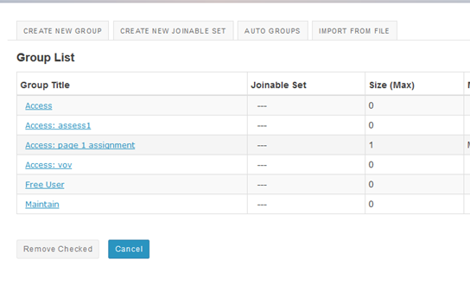
Grouping by Role
Create group for individual role by using Site Info tool, this can be done by site owner.

Slide 14
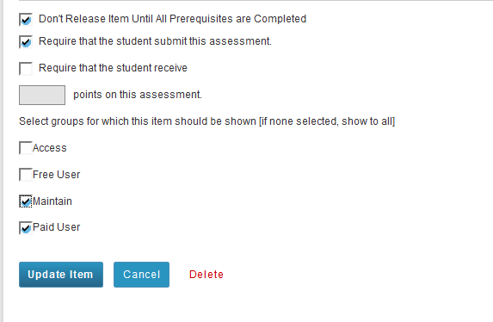
Grouping by Role
Site owner can edit the setting for each content of Lesson for controlling permission and not to release selected content if the student did not submit the previous content.

